Slide 1

Developing a Raspberry Pi based
IoT Sensor for Flood Sensing
Paul Oscai
Master of Science Project Presentation,
Computer Science Department,
Tennessee Tech

Slide 2
Motivation
Floods are a source of concern because they cause loss of life and billions in damages [5].
Affects agriculture, water management, safety, engineering/construction of waterways [6].
Commercial detection systems exist but they are very expensive and many communities cannot afford them [9].
Notes:
Explain flood damage- not work of others.

Slide 3
Problem Statement
Creating a low-cost solution to detect changes in water level and predict flood, using Raspberry PI and a Camera module
Notes:
Explain flood damage- not work of others.

Slide 4
A better solution is needed
Measuring water level can be expensive.
USGS study shows capital cost between $5,000-$10,000[1]
A study claims the cost of installation to be $300,000[2]
Existing methods work but can be affected by various anomalies [3]
stilling well- bias errors, high maintenance cost
ultrasonic- sensitive to temperature, and high waves
pressure gauges- seasonal shift

Slide 5
Project Objective
Create a sensor that is able to visually interpret and record data.
Use visual data to indicate flood status
Certain change in measurement values indicates flood
The sensor should be autonomous
Can work with a battery module and solar panel
Can upload data to the cloud
Cellular Connectivity
Upload
Power (Solar + battery)
Google Cloud (Data Repository)
Camera
PI
Sensor
Notes:
I don’t want to ramble here. Need to explain that end goal is a quick response.

Slide 6
Methodology and Contributions
(My contributions in the overall project are in red)
Building a prototype with PI, camera, cellular connectivity module, solar panel and battery module <- Partial contribution
Tuning power parameters
Configure network connectivity
Create program to measure water level
Configure remote storage on Google Cloud and upload Data
Deployment
Notes:
- Clear explain

Slide 7
Contribution 1: Building a prototype with PI and camera
Assembling the Raspberry PI (RPI) components
I ensured the battery and LTE Cellular modules work with the RPI
Several Initial problems
PiJuice battery module
Sensitive to shock and vibration
Low charge shutoffs
Reboots with many peripherals
and more….
LTE module
need to manually create network interface
need to manually configure services
Where to store data?
need cloud storage
Will elaborate on each of these in the next slide
Result: The Raspberry PI works with PIJuice and LTE module

Slide 8
Contribution 2: Configuring PiJuice Battery Module
First task -
Run program, determine battery life expect.
Record which peripherals worked together
Record observations
power overflows
flags
system task scripts
Encountered several errors and need to handle them
Possible errors: Software (e.g., SSL) errors, water level detection error, hardware etc.
Developed scripts that
manage device with shutdown and wake up
integrate with OS and crontab
create SSH and VNC tunnels to study remote placements
Notes:
autonomous

Slide 9
Adding a Solar Panel
Even with tuning, the battery alone was not enough to keep the sensor running more than 2 hours
Added a small solar panel
First solar panel was 3.5W 5V
could only charge the Pi in small bursts with full sunlight
also needed the Pi should be fully shut down.
Added a larger panel
Can keep the sensor on for more than 12 hours
Battery still drains after 3-4 hours once the solar stops charging
Need larger battery
Tuned the battery parameters further to keep it running longer
We can now keep the PI up the whole day and 3-4 hours after sunset

Slide 10
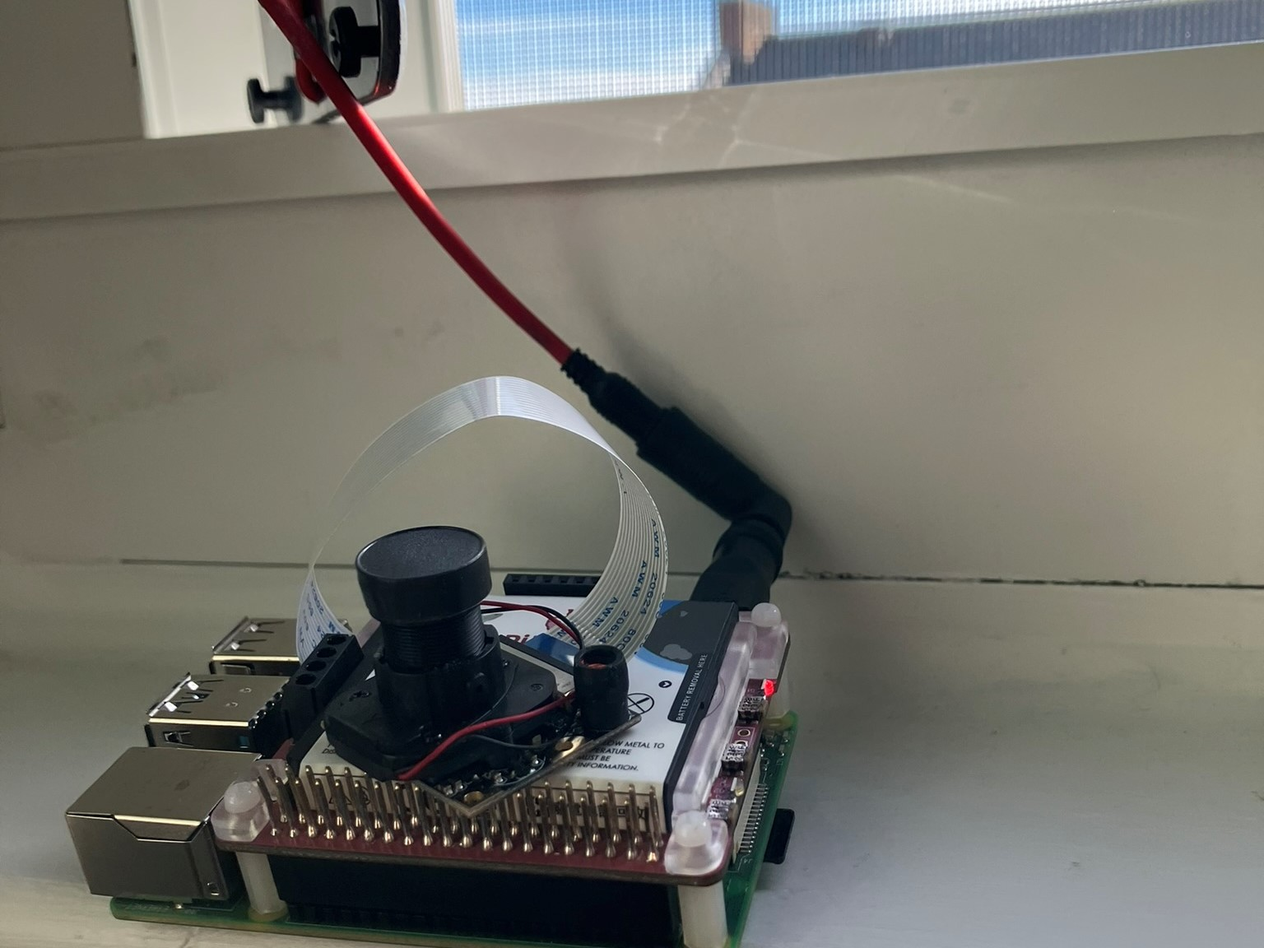
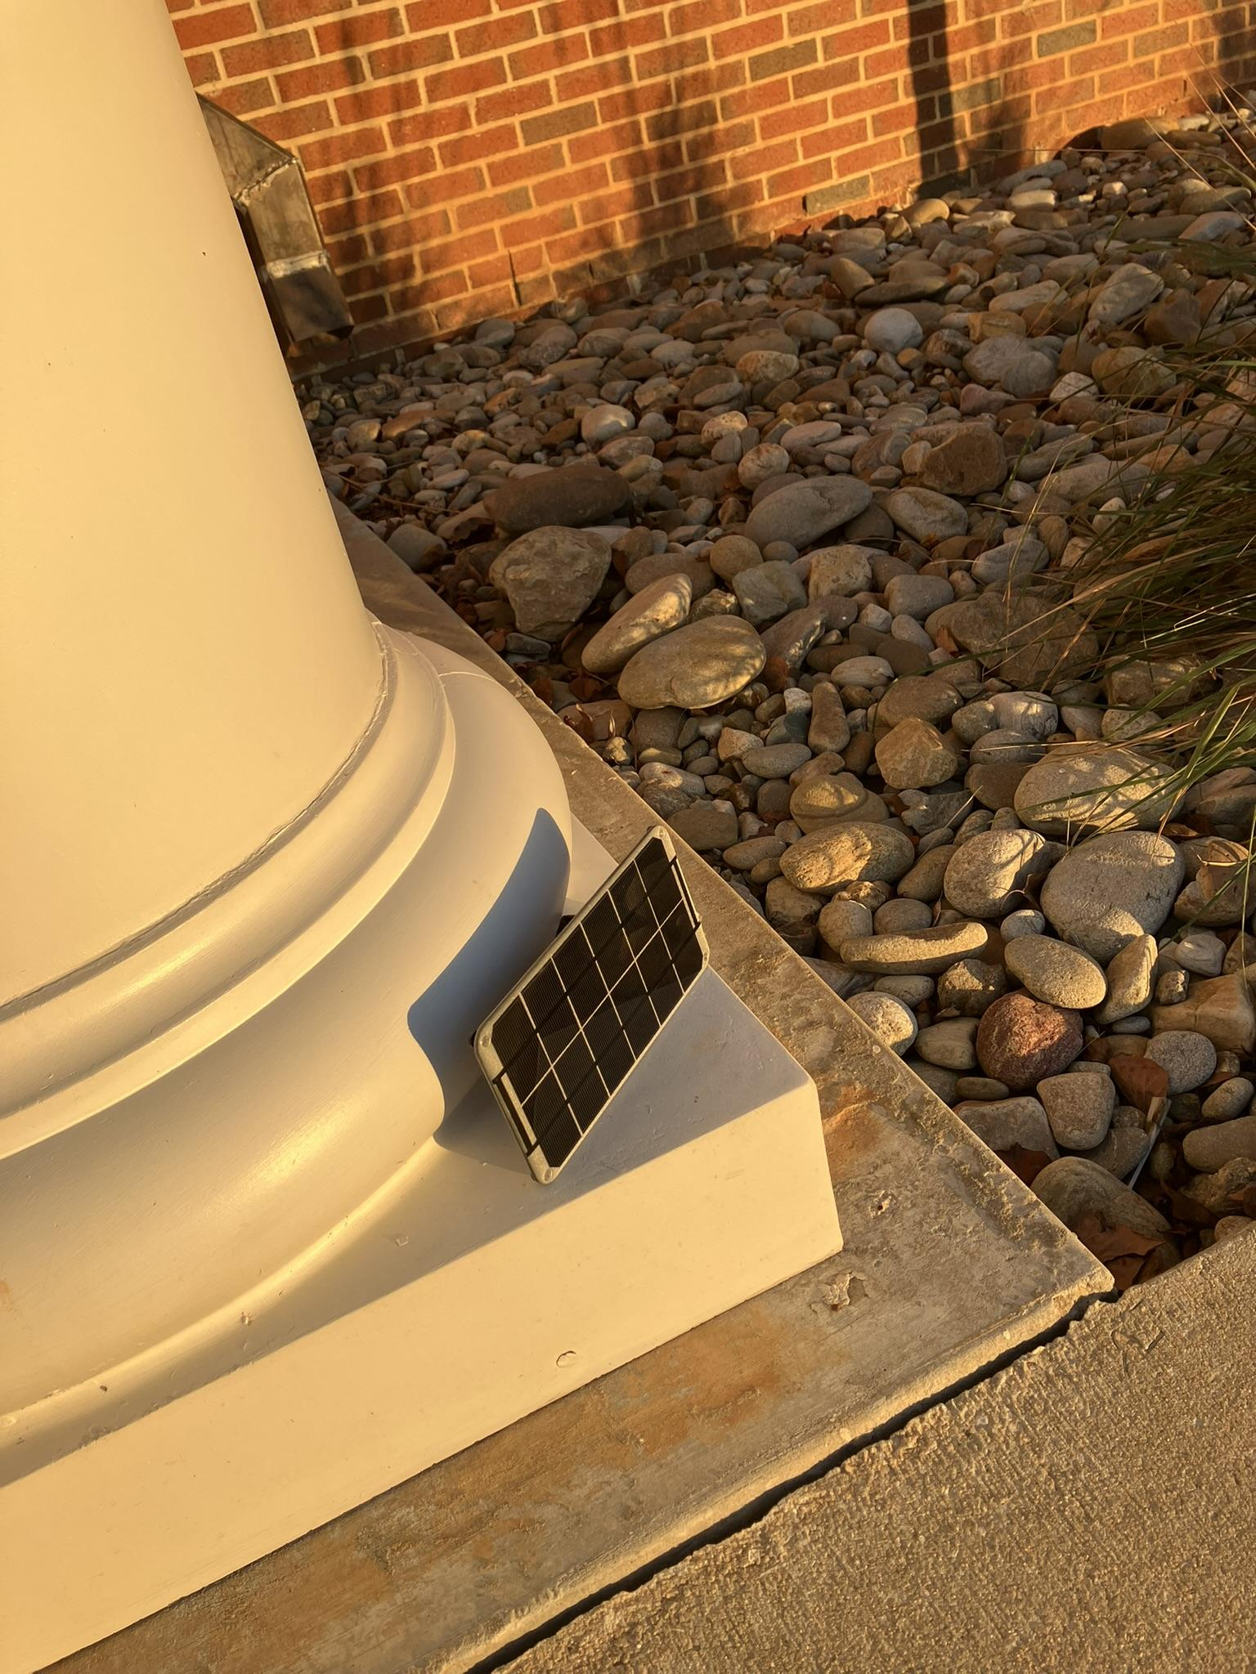
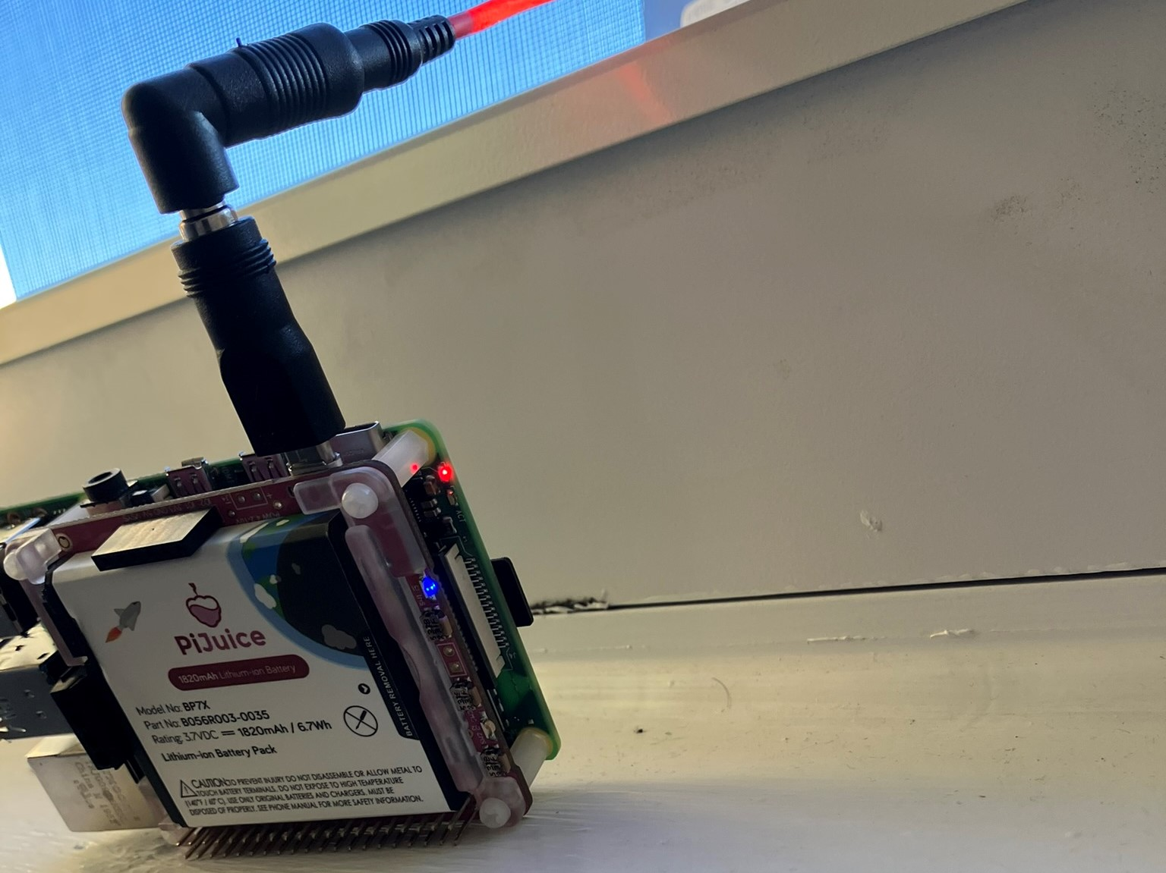
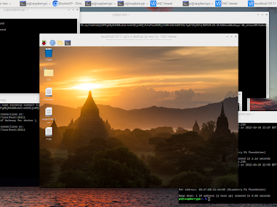
Configuring Solar Panel
v
Initial testing:
Device must be powered off to receive any level of charge
LEDs can indicate status, remote connection for details
More information new solar panel

Slide 11
Contribution 3 - Wireless HAT
Goal -
Automatically connect to the cellular network after boot-up
Problem:
Needed to manually create the network interface
Needed to manually start network services at a particular time for it to work
Solution:
Created a set of scripts to automate connectivity

Slide 12
Configuring Network Connectivity
Investigated the best network provider in our area
T-Mobile
Configured LTE module to work it
Created Point to Point Network Interface
Advantages: suffers less from “last-mile” connectivity
Tested and confirmed functionality in local lab
Used commands to obtain and check career info, signal strength, and other parameters
Checked connectivity using “ping” utility
Consolidated the steps in a script to automate network connectivity after reboot
Automatically create a cellular interface and run service to activate it
Activate route to the Internet
Check Connectivity using ping

Slide 13
Autonomous Program
Findings:
Best way to use pon (modem ) is to direct pon to use the configuration file for our APN.
Route can be automatically created
Connection should be created in background script with root privilege
Device connects to network on startup and works for ~2-3 seconds and can reset after startup
Sometimes the connection resets after startup, pon provider will try again in the background
Best way to ensure reliable connectivity is to wait ~30 seconds after boot-up with a terminal
Results - The PI is able to connect to the cellular network automatically
Caveat - The PI is currently using WiFi to upload data. We need to test seamless switching between WiFi and Cellular.

Slide 14
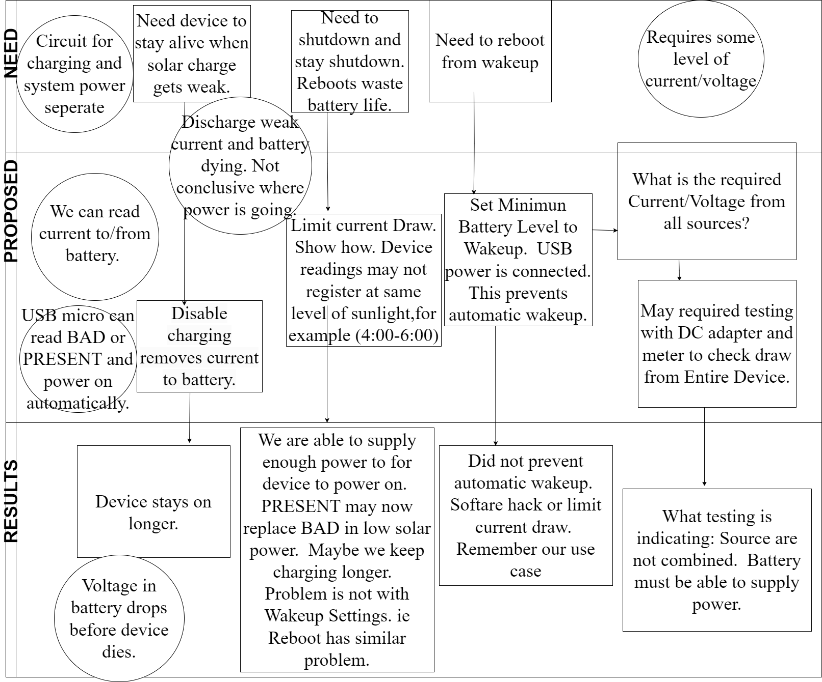
Reading this Chart
Circle: What we know.
Box: Follow Depth in chart.

Slide 15
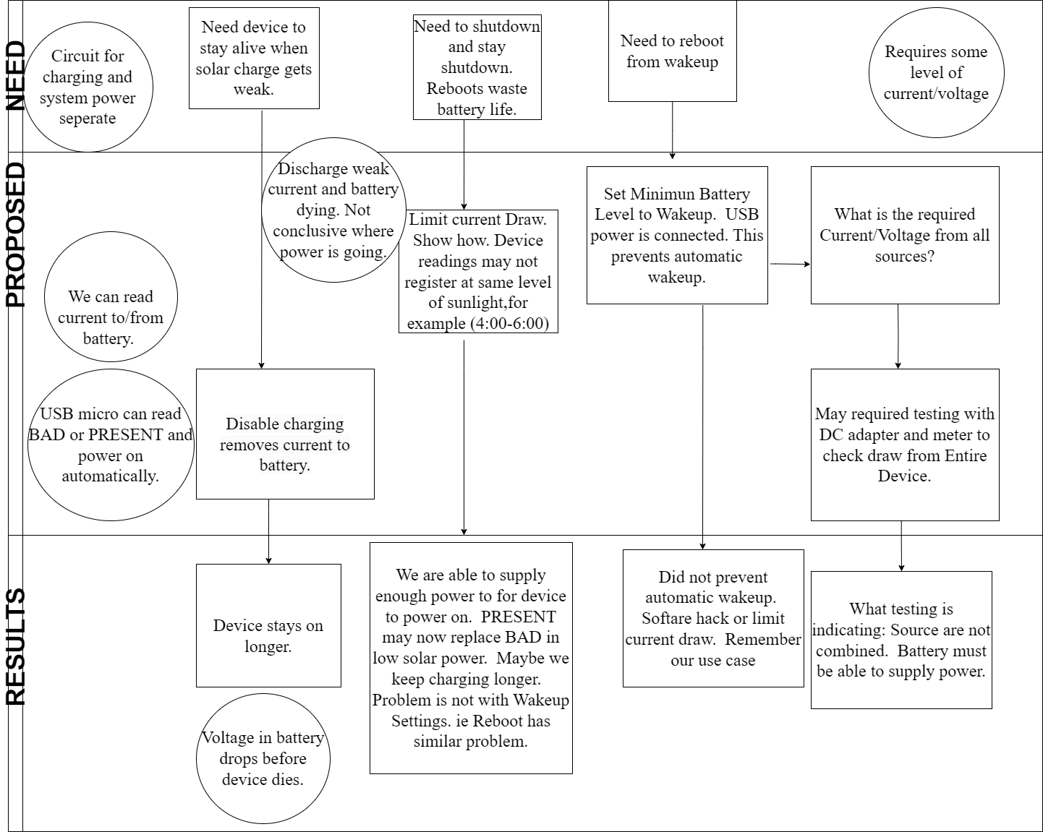
Reading this Chart
Circle: What we know.
Box: Follow Depth in chart.

Slide 16
Tuning Battery Parameters- Findings
Findings:
The battery module needed several tests and tweaks
Tuned multiple parameters to optimize battery usage by automating device shutdown and wake-up
battery state (present vs connected)
charge level
current draw
Results -
The PI is able to work with battery and solar.
It stays on for about 3-4 hours after sunset.
Still needs larger battery

Slide 17
Methodology and Contributions
(My contributions in the overall project are in red/yellow)
Building a prototype with PI, camera, cellular connectivity module, solar panel, and battery module <- Partial contribution
Configuring PiJuice module
Configure network connectivity
Create program to measure water level
Configure remote storage on Google Cloud and Upload Data
Deployment
Notes:
- Clear explain

Slide 18
Contribution 4 - Integrate with Cloud Storage
Goal - Upload data to cloud for long term storage and analysis
Several steps are needed to upload data to Cloud
Configured Service Account Authentication via Google Cloud API (rather than password)
More functionality than API Keys
Run from the command line without having to use a browser
User is not involved in the consent
Program can either use mimeType text/plain or image/png
Created naming scheme of files
Developed program to upload, list, search and download file(s)
Program to create and organize within folders

Slide 19
Contribution 4 - Integrate with Cloud Storage
Goal - Upload data to cloud for long term storage and analysis
Program to parse through data files
Matplotlib programs to visually represent scatter plots adding color, legend, and specified intervals
Results- Created a program to upload and store data on Google Cloud.
This program has been tested and is periodically uploading pictures taken by the sensor.

Slide 20
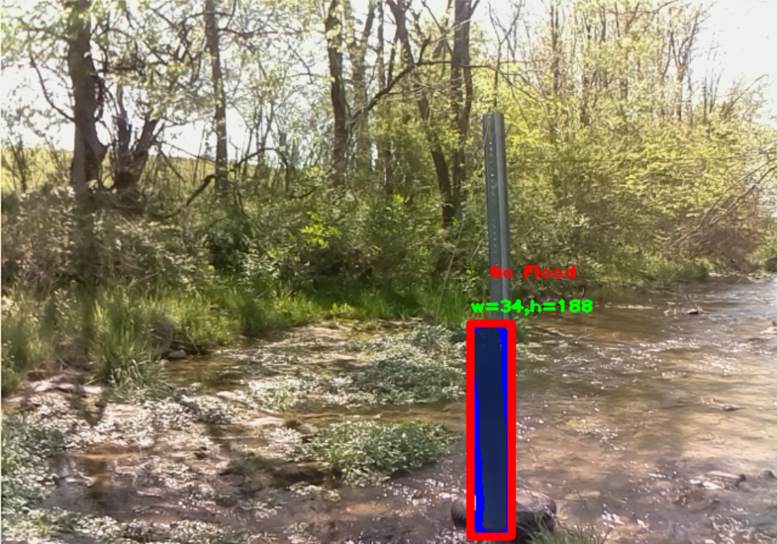
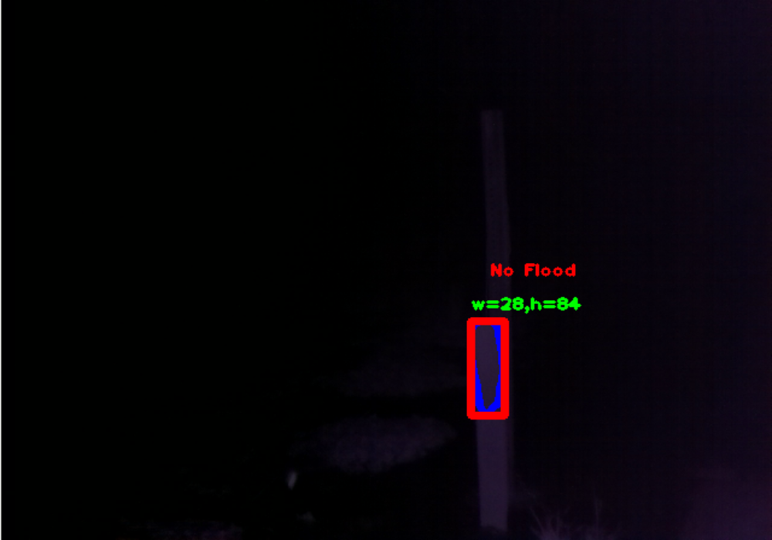
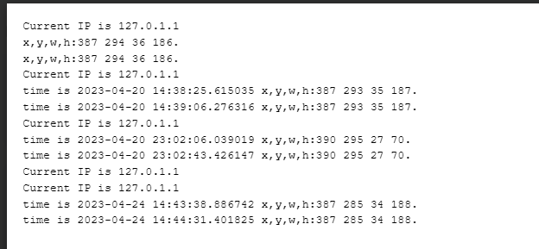
Uploading Data Works!
We can automatically upload pictures and logs.

Slide 21
Summary - What did I accomplish?
Goal | Status | Notes
Building a prototype with PI and additional modules | Done | Configured the LTE hat and PI Juice module
Configuring PiJuice Module | Done | The PI is now powered by the PiJuice and a solar panel
Configured network connectivity | Done | Created a set of scripts to automate network connectivity
Upload data to cloud storage | Done | Created a set of scripts and configurations to upload data automatically to the cloud storage

Slide 22
Future work
Battery issue is the main bottleneck in this project
Works with all the peripherals BUT
We need larger battery and further optimize current draw
We have tested cellular connectivity and WiFi works
We need to test the cellular connectivity and WiFi working together

Slide 23
References
Fulton, John W., et al. "Near-Field remote sensing of surface velocity and river discharge using radars and the probability concept at 10 US geological survey streamgages." Remote Sensing 12.8 (2020): 1296.
Hiroi, Kei, and Nobuo Kawaguchi. "FloodEye: Real-time flash flood prediction system for urban complex water flow." 2016 IEEE SENSORS. IEEE, 2016.
Intergovernmental Oceanographic Commission. Manual on Sea-level Measurement and Interpretation: Volume 3. Intergovernmental Oceanographic Commission (IOC) of UNESCO, 2002.
PiJuice, https://github.com/PiSupply/PiJuice/tree/master/Hardware /#power-management-and-batteries, Last Accessed: May 02, 2023
Arshad, Bilal, et al. "Computer vision and IoT-based sensors in flood monitoring and mapping: A systematic review." Sensors19.22 (2019): 5012.
Zhang, Zhen, et al. "In-situ water level measurement using NIR-imaging video camera." Flow Measurement and Instrumentation 67 (2019): 95-106.
PON, https://manpages.ubuntu.com/manpages/bionic/man1/pon.1.html, Last Accessed: May 02, 2023

Slide 24
References
Klemas, Victor. "Remote sensing of floods and flood-prone areas: An overview." Journal of Coastal Research 31.4 (2015): 1005-1013.
Ogie, Robert Ighodaro, et al. "Optimal placement of water-level sensors to facilitate data-driven management of hydrological infrastructure assets in coastal mega-cities of developing nations." Sustainable cities and society 35 (2017): 385-395.

Slide 25
Thanks and Acknowledgements
Jacob Latham - Worked together on this project
Dr. Alfred Kalyanapu, Civil and Environmental Engineering
Dr. Denis Ulybyshev, Computer Science Department

Slide 26
DO NOT USE SLIDES BELOW THIS

Slide 27
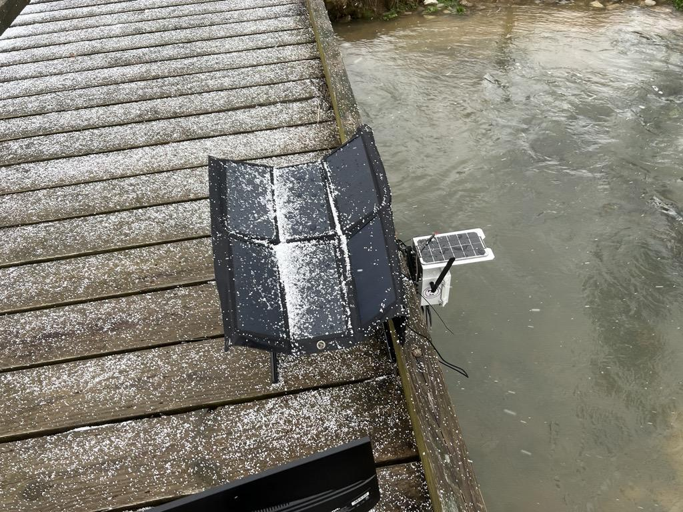
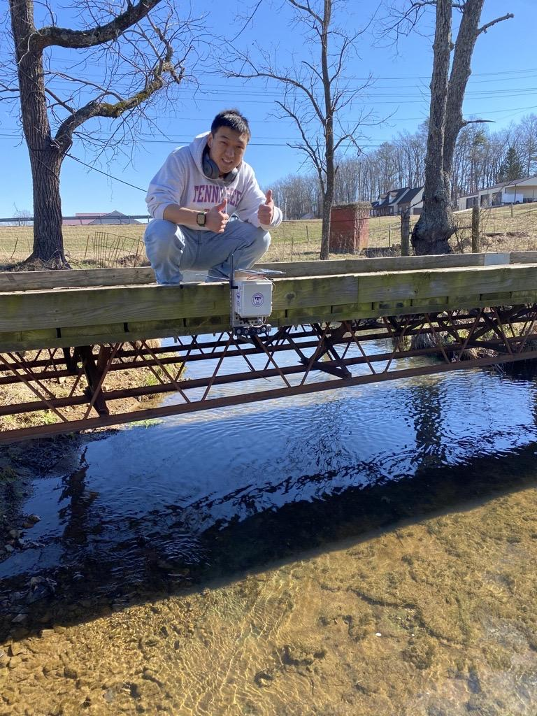
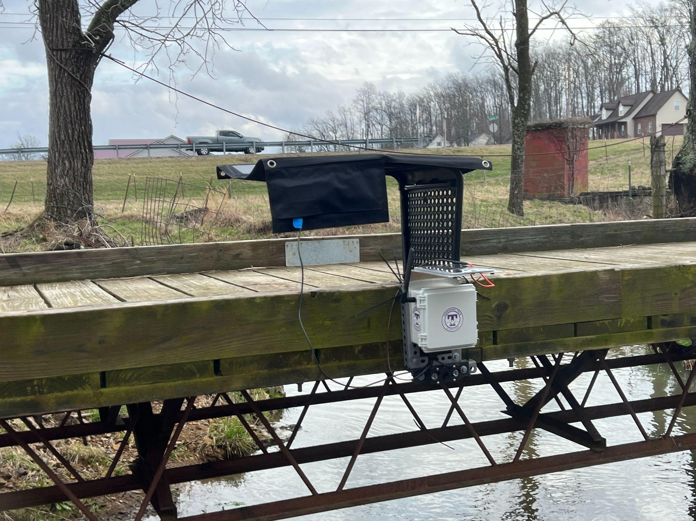
Initial Deployment
This is the Initial Deployment of the Flood Early Warning System (FEWS)
TNTECH Computer Science with the guidance and support of Civil Engineering Department.
FEWS is based on a RPI 4 system with low cost making this a cost effective and worthwhile solution.

Slide 28
What did we learn?
Learned that working with RPI in remote locations can cause tremendous level of intricate problems.
We use a 3.7V battery to charge and power the device. We have learned that while charging, the device has sufficient voltage, but shows unpredictable behavior that must be addressed.
The software for the charge controller is very convenient, but is complex as it interfaces with the I2C and Serial ports on RPI. Keep accurate clock, monitor voltage problems
What charge level should RPI wake up at as this is an option that disturbs schedule.
Do we turn off charging to save battery? May not always work.
Cellular hat programming can be tricky. The device can connect to the Internet and disconnect even before the bootup completes.

Slide 29
Show sample data/images from the Google Drive
We learned that working with RPI in remote locations can cause tremendous level of intricate problems.
We use a 3.7V battery to charge and power the device. We have learned that while charging, the device has sufficient voltage, but shows unpredictable behavior that must be addressed.
The software for the charge controller is very convenient, but is complex as it interfaces with the I2C and Serial ports on RPI. Keep accurate clock, monitor voltage problems
What charge level should RPI wake up at as this is an option that disturbs schedule.
Do you turn off charging ?
Cellular hat programming hurdle. The device can connect to the internet and disconnect before the bootup completes.

Slide 30
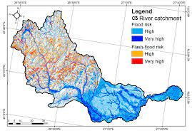
Ecology Standpoint
Floods are a source of concern because they cause loss of life and billions in damages.
It may be difficult to alert people because of unpredictability of such events.
Also in times of flood human components might be compromised such as Internet, lights and power.
Autonomous detection might help but commercial sensors are very expensive.
Many cities and rural communities cannot afford them.
Flood Hazard Mapping (MDPI)

Slide 31
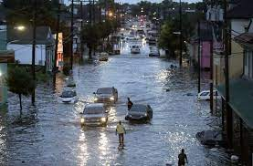
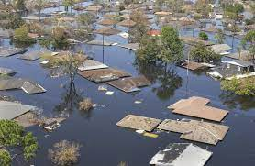
Water level Control Overview
Water levels are measured in projects and kept in accurate records.
Water levels can determine volume, trends, and in our case the occurrence of floods.
Lots of variations to monitoring flood.
Promising approach
Agriculture, water management, safety, engineering/construction of waterways and ecological study
Recreation in local areas

Slide 32
Presentation of FEWS
This is the Flood Early Warning System (FEWS)
TNTECH Computer Science with the guidance and support of Civil Engineering Department.
FEWS is based on a RPI 4 system with low cost making this a cost effective and worthwhile solution.

Slide 33
Relevant Work
Other works approach the problem bring different skills to their advantage being Wireless networks, Machine Learning models, detection with strategies for adapting to disaster.
Differencing Imaging technique is not unlike ours but does not scale and is out of scope of our project design.
We feel that we can improve on this method.
Others use very limited test data, and do not go on about how to improve on detection or increase outcome [Vinothini].
Some projects work one specific site such as we do, but scope and goals for data acquisition are unclear. (Ie) Using SIFT algorithm and how to integrate into field

Slide 34
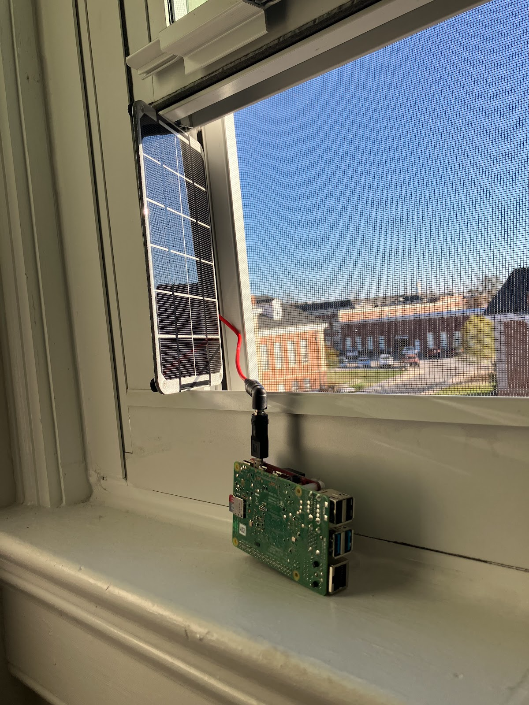
Overview
We want to explore the possibilities of projects using the Raspberry Pi 4 equipped with the HD camera
Our goal is to create a rapid response that can deal with challenging issues. These are expensive remote setup, maintenance, monitoring and high frequency of data. Then you can establish that you have accurate results.
We have made some changes through the project.

Slide 35
Overview – contd.
We use an algorithm equipped in machine to sense level of water in the image after taking the picture.
Device will keep a healthy store of photos that will enable it to make quick decisions on when to induce a warning.
Algorithm keeps a small queue of photos on each iteration that can aid in the detection of rapids- the utility is to be seen.
We have tried to create a device that will operate with minimal deployment effort to use imaging to give us details about rising water levels.
In particular, we wan to use the knowledge about flooding to apply to other approaches (segmentation, reflection)

Slide 36
Steps to Delivery
We have had to make the RPI device work in an environment with little human interface due to the remote nature of the project.
It is imperative that we can use the device and have knowledge of its physical, hardware, and software and understand how each piece works together.
Initial stages saw developments to allow PI to work as expected on its own. This included
establishing wireless connectivity
creating reverse ssh tunnel
configuring the use of solar panel
adjusting settings for charge controller
working on a program that required no access to the device and allowing data to be stored on the cloud GCP.

Slide 37
Security and Software
We have to use different entrances and expose our system to potential flaws.
We use Google Drive to connect to Api around 5 times for each flow. We can work to lower that with compressed, concatenated uploads.
We have to pay attention to details of private keys used for connecting to device in the ssh flow. It may be a good idea to re-establish these periodically.
Wireshark can show information about our flow even in an encrypted TLS layer.
Our memory contains information about a service account for the Google Project. This should be safe and modified for security reasons if a misuse can be detected.

Slide 38
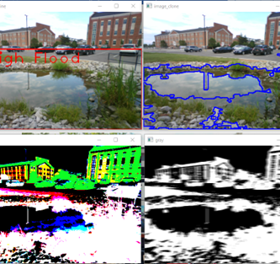
Development of Flood Detection
We have surveyed a variety of ways to use the camera and python programs to detect water levels.
The first tried to create a contour to distinguish between land surface and water level.
This proved to be faced with difficulties finding one bounding separation between the two to create a result on the Pi and upload to the drive.

Slide 39
Idea using Computer Level Sensor
We next used the idea of creating a reader of a staff gauge with a computer program which would take measurements.
We were able to successfully implement this by finding the bounding box using cv2 in python.
The bounding box creates coordinates from the image file which shows where the object fills the smallest rectangle. We reference the distance from the bottom of the object and use a height threshold to quantify what the data is telling us.
With some minor adjustments on the gauge and with secure and proper placement, we were able to reliable take measurements from the device.

Slide 40
Computer Level Sensor
This program takes the picture, and processes by converting color to create effective separation of noise. We then use a contour device and a bounding box to find the coordinates of the object we have placed.
The water height is the available amount of image that is left on the staff after subtracting difference from ground.
Levels are appended to a log file which we examine in the cloud context to create a forecast on the status of flood levels.
Functionality will increase- we plan to integrate data into a workflow using Google Cloud Functions and possibly other Machine Learning and Statistical metrics.

Slide 41
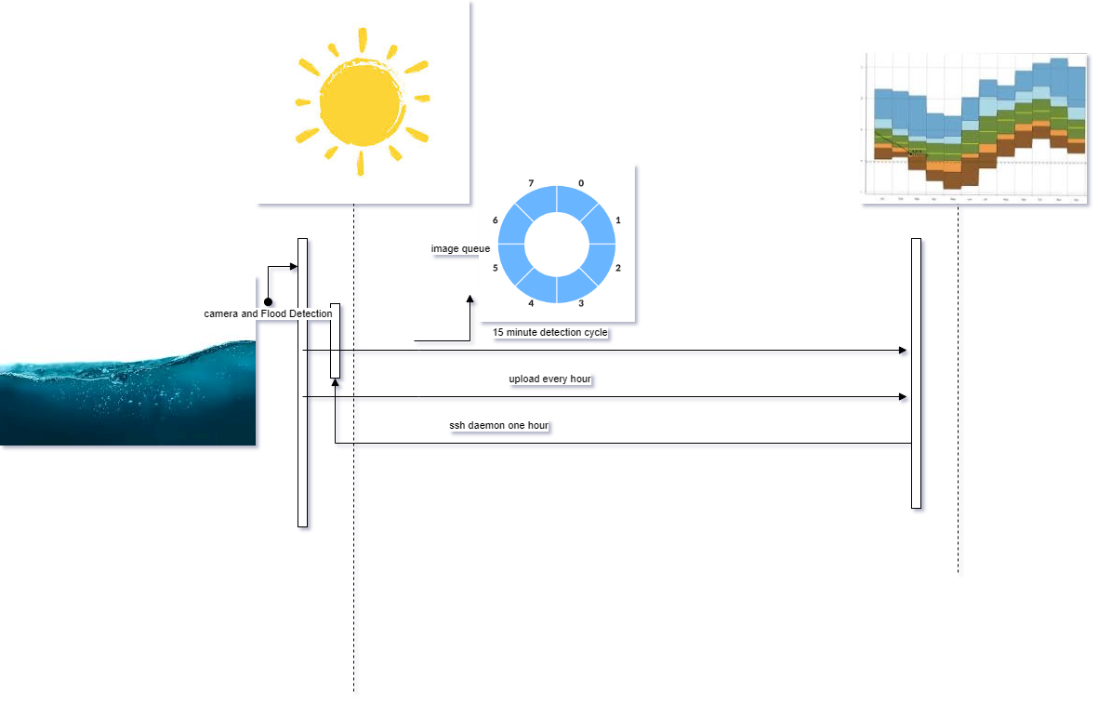


Slide 42
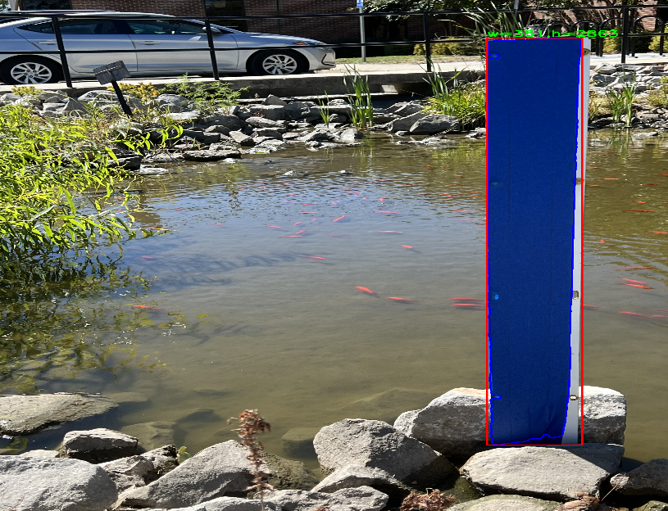
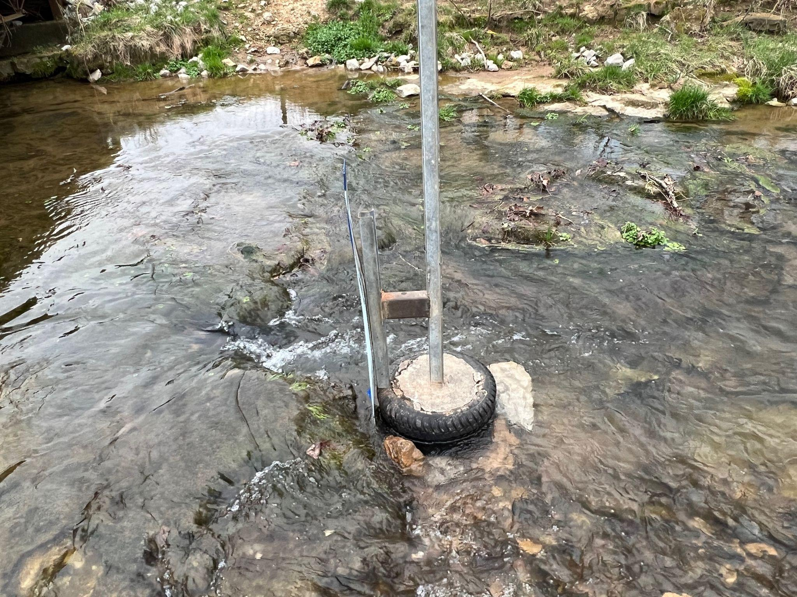
Implementation
We have deployed the system on nearby location.
We have a unique view of a location to monitor for water level.
Results include streamflow, water volume, and short term and long term water planning and event alerts.
We will have data comparable to stream gauge measurements. USGA keeps records of information of this type in an online site database
Streamflow is measured by hand and is done more infrequently than can be accomplished by a detection program.
There are ways to improve upon process. This will be revealed.

Slide 43
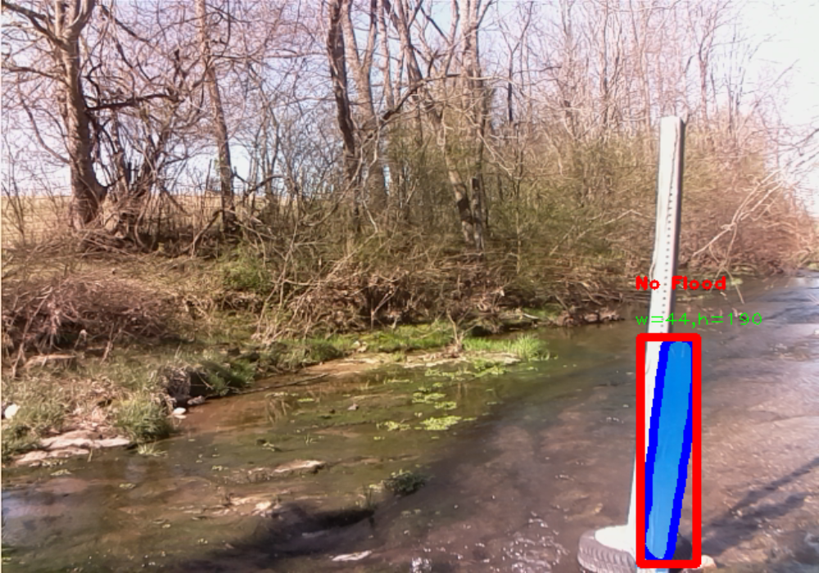
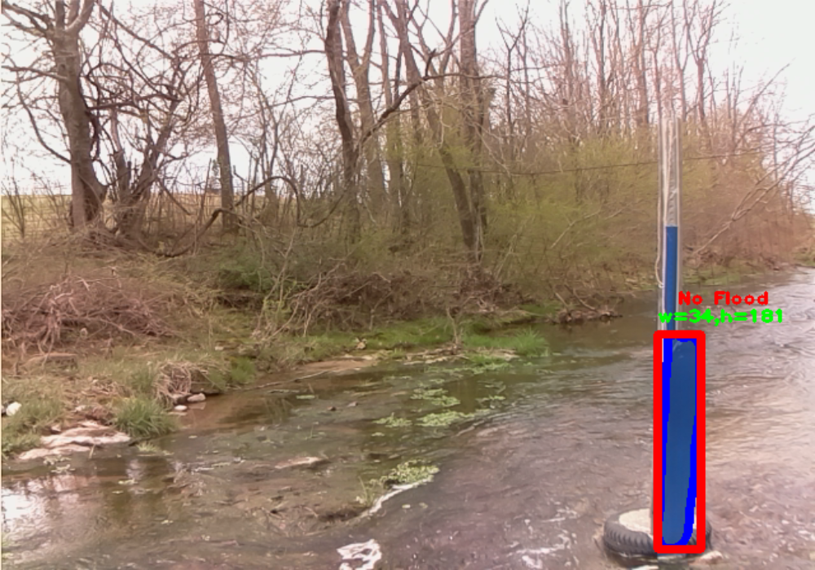
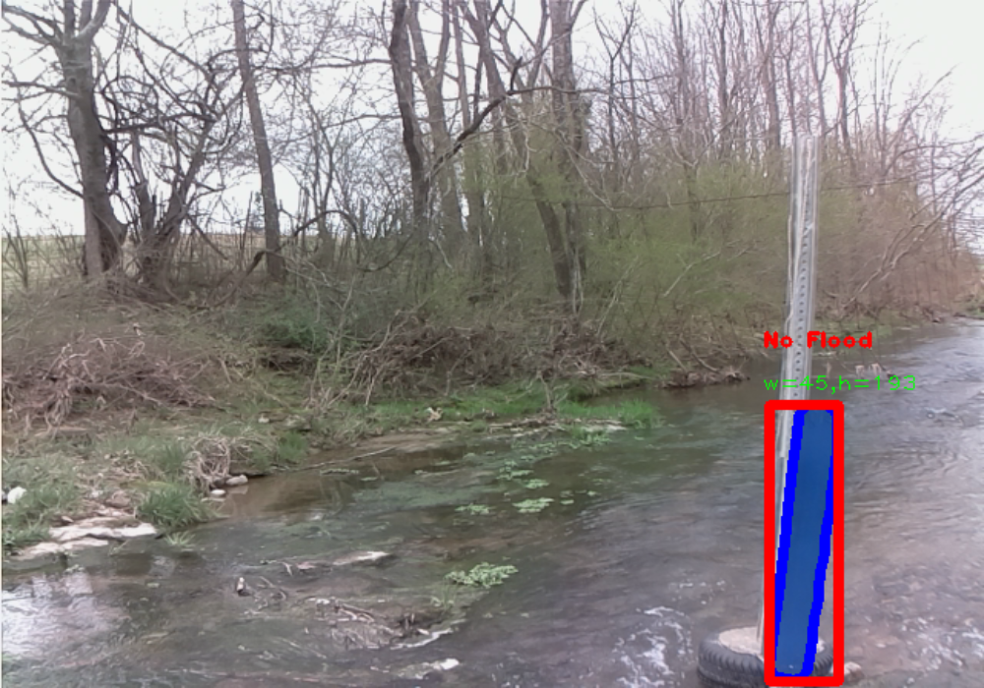
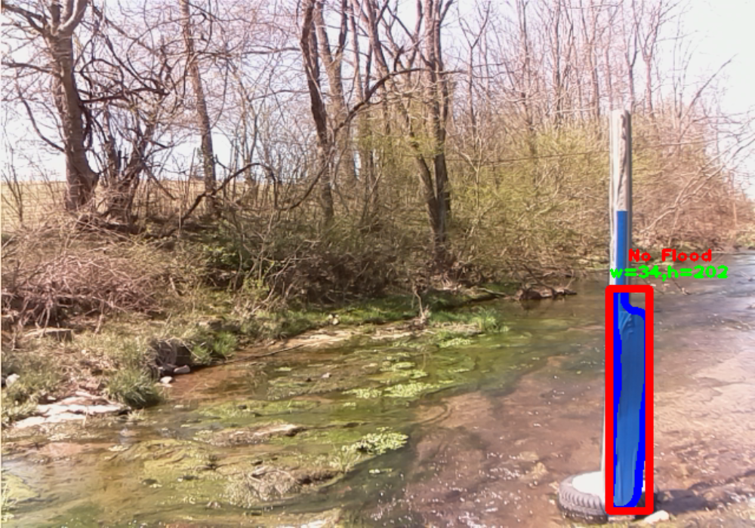

Slide 44
Next steps and concepts to realize in FEWS
We have a team at Tennessee Tech that gather sensor data.
We can do comparative studies to determine the success of our approach.
Data is useful and helps improve calculations of other readings.
Moreover, we can quickly scale and add focus to a given area, or range of areas with this same methodology.
Other types of sensors used to solidify studies are ultrasonic sensors, water flow sensors (magnet and current calculation), ultrasonic radar, stiller, radar, soil measurement, rainfall sensor, water cover on agriculture, erosion.

Slide 45
How to model and quantify data
We have gathered data as a flow of heights and widths to measure flood levels.
R Squared? How does my data predict other data?
Percent Bias? How are my measurements in their own right?
Loess seasonal decomposition? How is my data unique?
Nash-Sutcliffe

Slide 46
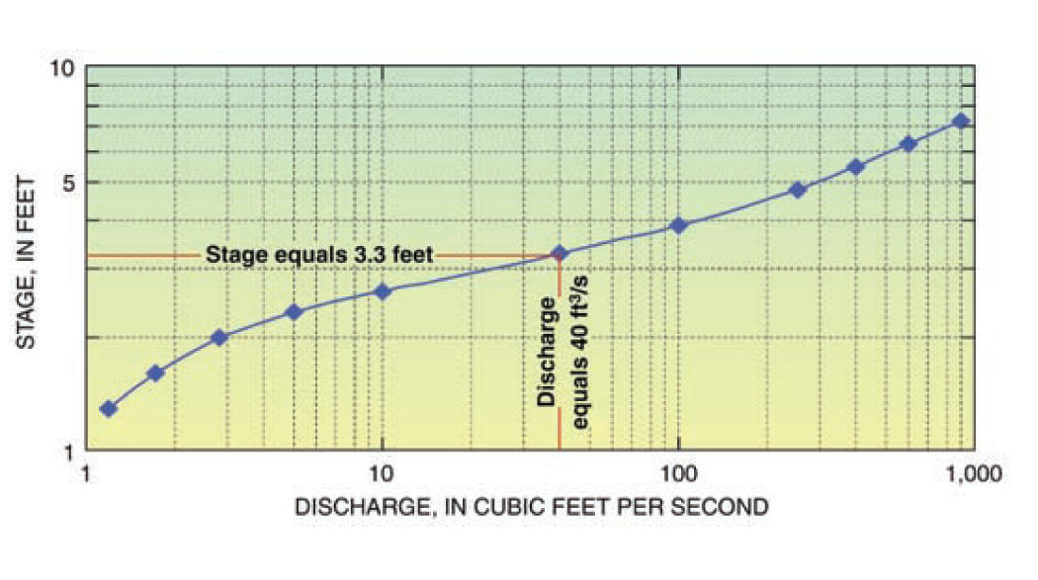
Improving our Accuracy
We can validate results with visual representation.
Find a stage-discharge or storage-capacity curve.
Measurements for water velocity get complicated, and the use of a greater number of data sources will produce more thorough results.
www.usgs.gov

Slide 47
Computer vision calculations
Works read - How do they confirm results? Alert to floods according to official data.
Are testing done once flood detection is complete?
The use of computer vision allows for calculations at different depths on different objects. Advantages accumulate when you have a good data.
We have solved many challenges, but we should define what it means to alert to a flood.

Slide 48
FEWS helps realize goals in computer vision
FEWS can vastly increase throughput on an individual device, but gives a clear way to create larger scale projects.
Many ways to improve.
Effective edge processing, combination of data on device, efficiency as rise of data transfer.
We have the ability to program and increase performance.

Slide 49
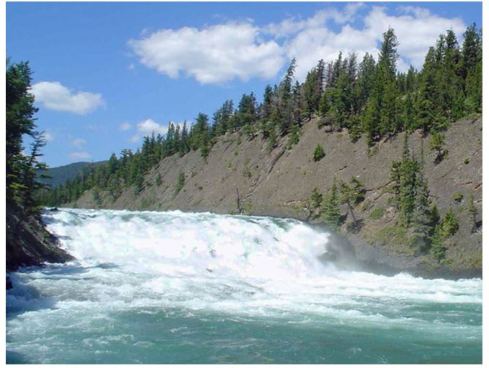

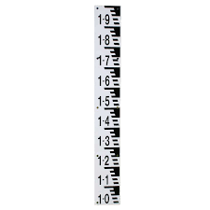
Rapid Reaction
Raspberry Pi can store a large dataset of photos in memory to become aware to trends in water level or abnormalities of conditions.
We can include multiple measurements in a locality due to staff gauges with efficiency.
Raspberry Pi FEWS has been programmed to check for occurrences that indicate flooding conditions every 15 minutes.
Visual feedback

Slide 50
Field Durability
Solar panel powered Pi is an excellent way to build a large scale IoT network with potentially many components
Components being checking data, different water level sensors, temperature and weather sensors, additional measurements for more robust depth accuracy
Currently, we are working with voltage supply to the pi from our battery as our charging is effective and worthwhile for our purposes.
Connectivity is typically very quick on bootup ~ 2-3 seconds.

Slide 51
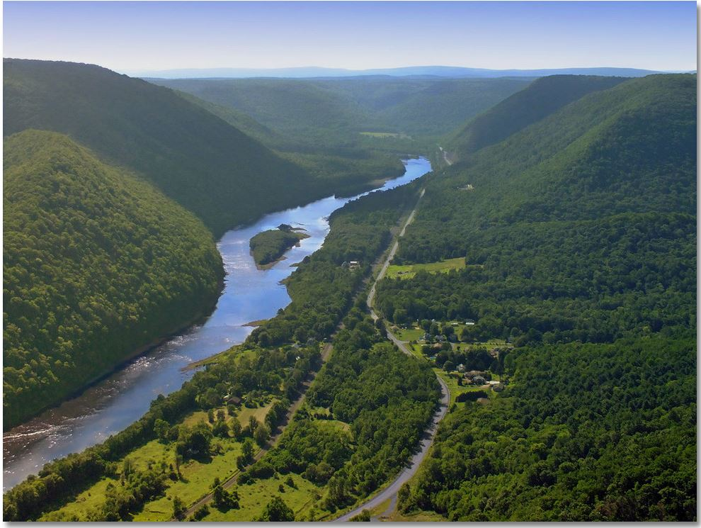
Local Area
We have access to several great testing spots.
RPi can function as a Gateway with other devices using Software defined Radio.
A sensor network will increase accuracy provide more diverse data. Our pi currently acts as its own gateway, however the strategy can vary based on the sufficiency of current findings.

Slide 52
Gains Considerations and Thanks
Struggles can build on eachother.
Concerns in the form of extra process and services, potential open ports, malware threats, software hangups. These issues can be resolved with patience and hard work.
I learned valuable skills and wisdom with a great team. I am proud to have been associated with my team members. There is so much to be learned from FEWs.

Slide 53
References
Kalyanapu, A.; Owusu, C.; Wright, T.; Datta, T. Low-Cost Real-Time Water Level Monitoring Network for Falling Water River Watershed: A Case Study. Geosciences 2023, 13, 65. https://doi.org/10.3390/geosciences13030065
How Streamflow is Measured | U.S. Geological Survey (usgs.gov)
Fulton, John & Mason, Christopher & Eggleston, John & Nicotra, Matthew & Chiu, Chao-Lin & Henneberg, Fernanda & Best, Heather & Cederberg, Jay & Holnbeck, Stephen & Lotspeich, R & Laveau, Christopher & Moramarco, T. & Jones, Mark & Gourley, Jonathan & Wasielewski, Daniel. (2020). Near-Field Remote Sensing of Surface Velocity and River Discharge Using Radars and the Probability Concept at 10 U.S. Geological Survey Streamgages. Remote Sensing. 12. 1296. 10.3390/rs12081296.

Slide 54
References
Version:0.9 StartHTML:0000000386 EndHTML:0000002255 StartFragment:0000000422 EndFragment:0000002219 SourceURL:https://scholar.google.com/scholar?hl=en&as_sdt=0%2C43&q=IoT+Based+Flood+Detection+and+Notification+System++using+Decision+Tree+Algorithm&btnG=#d=gs_cit&t=1679637427265&u=%2Fscholar%3Fq%3Dinfo%3ACQ_gXx7yXdoJ%3Ascholar.google.com%2F%26output%3Dcite%26scirp%3D0%26hl%3Den Vinothini, K., and S. Jayanthy. "IoT based flood detection and notification system using decision tree algorithm." 2019 international conference on intelligent computing and control systems (ICCS). IEEE, 2019.

Slide 55
What is uniquely different?
Obtains real time flood data in an area due to lack of data or accuracy of data
Flood sensors have weaknesses including
High cost
difficulty in maintaining equipment
requiring reference data and support from server to reconstruct images
failure in the presence of obstructing forces (rain, debris)
use functions that can detect two or more (incorrect) measurements in a region of interest
height data hard to obtain
alerts not thoroughly tested for accuracy
Notes:
-> Added functionality

Slide 56
Author | Response | Takeaway
Vinothini- “IoT Based Flood Detection” | Response time not given Look into statistics True positive indicate flood? | Weak Dataset Lack of accuracy checking
Zhang- “In situ water level management” | No Focus on response No predictive model, data not quantified Verifed results? How much is measured? | More expensive equipment Faces difficulty in lighting and environmental conditions
Sabbatini “A computer vision system | No response | Only study variation Scalability intended
Kalyanapu “Low cost- Real time” | Data is checked for noise, accuracy, bias Response time | Cost per unit Natural infrastructure High discharge create large variations

Slide 57
Configuring Cellular Connection
Investigated the best network provider in our area
T-Mobile
Configured LTE module to work it
Created Point to Point Network Interface
Advantages: suffers less from “last-mile” connectivity
Able to configure different Access Points in configuration file. We use default APN
Commands for carrier info, signal, connection strength
Mainly tell us if SIM is working
Tested and confirmed functionality in local lab
Confirmed time to connectivity using simple connection test based on “ping” utility
We need to learn about drawbacks and this relates to overall capability.
Configuration steps to automate network connectivity
Create a cellular interface and run service to activate it
Activate route to the Internet
Check Connectivity
Results - The PI has a new wireless interface.

Slide 58
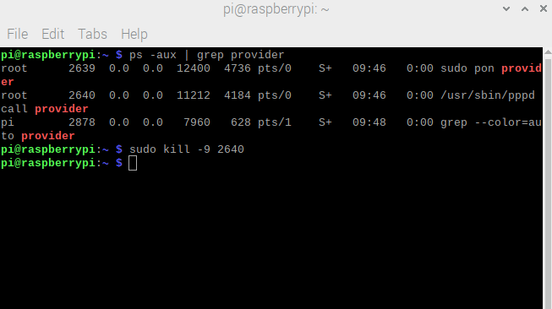
Configure Cellular Autonomous Connection
Autonomous connection
Small Test- Pon was making 3 connections. Route was failing to be created. Making route would kill other pon connections.
This is not a one off.
Found a solution:
provider is the name of isp and uses options in /etc/peers/provider
Not sure which options caused connection to start working.
Route created automatically
Pon is to start PPP connections [7]

Slide 59
Contribution 2 - Configure Cellular Autonomous Connection
Findings:
Device connects to network on startup of device and records connection ~2-3
When connected to monitor, connection resets and connection after bootup is ~30 seconds
Connection script uses an entire terminal and constantly runs and prints information. A background script is necessary.
Results - The PI is able to connect to the cellular network automatically
Caveat - The PI is currently using WiFi to upload data. We need to test seamless switching between WiFi and Cellular.

Slide 60
Contribution 1: Building a prototype with PI and camera
Assembling the Raspberry PI (RPI) components
I ensured the battery and LTE modules work with the RPI
Troubleshoot Power Modules and the LTE module
I tested the PiJuice battery module
Uninterruptible power supply
Solves voltage regulation problems
Several initial problems
Sensitive to shock and vibration
Low charge shutoffs
Reboots with many peripherals
and more….
Result: The Raspberry PI works with PIJuice and LTE module

Slide 61
Contribution 2 - Testing of Battery Module
PiJuice System Task is for:
Automatic scripts
Response to Hardware events
Options for Battery profile, Settings for input preference, LED settings, parameters like WakeUpOnCharge, MinCharge
Why?
We have to address future problems.
Error checking and logging
Possible errors: Software (e.g., SSL) errors, water level detection error, hardware etc.
Solutions are temporary right now
Keep device alive longer when solar gets weak
Keep battery level high enough to function correctly
Explore battery options
Explore less current draw in OS
I will show tests, then explain better solutions.
Summary- Data acquisition is the most important thing to be solved. We learned the problem in initial stage ( battery is at limit). What can we learn from now?
Notes:
autonomous

Slide 62
How to respond to problem?
Data shows that voltage is reaching a lower limit so we notice that battery is unable to supply to power device.
This may indicate an automatic shut off in PiJuice firmware/software.
To be able to reboot requires enough current/voltage. Are we getting enough?
We are, but appearance of power automatically starts system.
Tests show that even with BAD input, system will power on. This indicates a high current level
Wakeup options are at power, at minimum charge with power, and RTC alarm
Do settings conflict? I don’t think so.
Possible workaround
Remember to keep calculations rough: these are estimates
Are battery settings an option?
Reboot has worked before. Wireless HAT, Camera and Solar Panel all add current draw.
Summary:
We can keep battery voltage higher longer. There exist conditions which allow device to stay alive. 11PM pictures

Slide 63
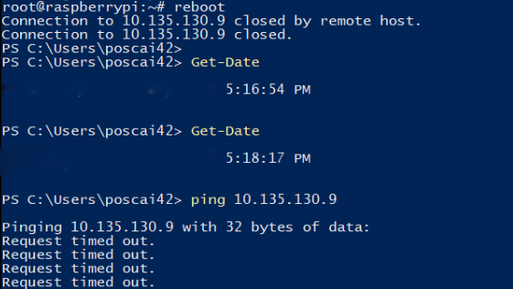
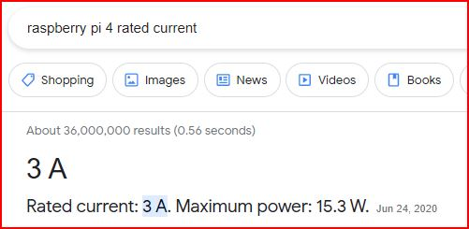
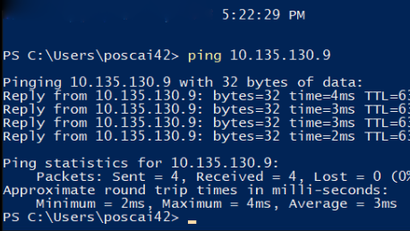
Studying behavior
Images show reboot time 5:16- 5:22. Three tests do the same.

Slide 64
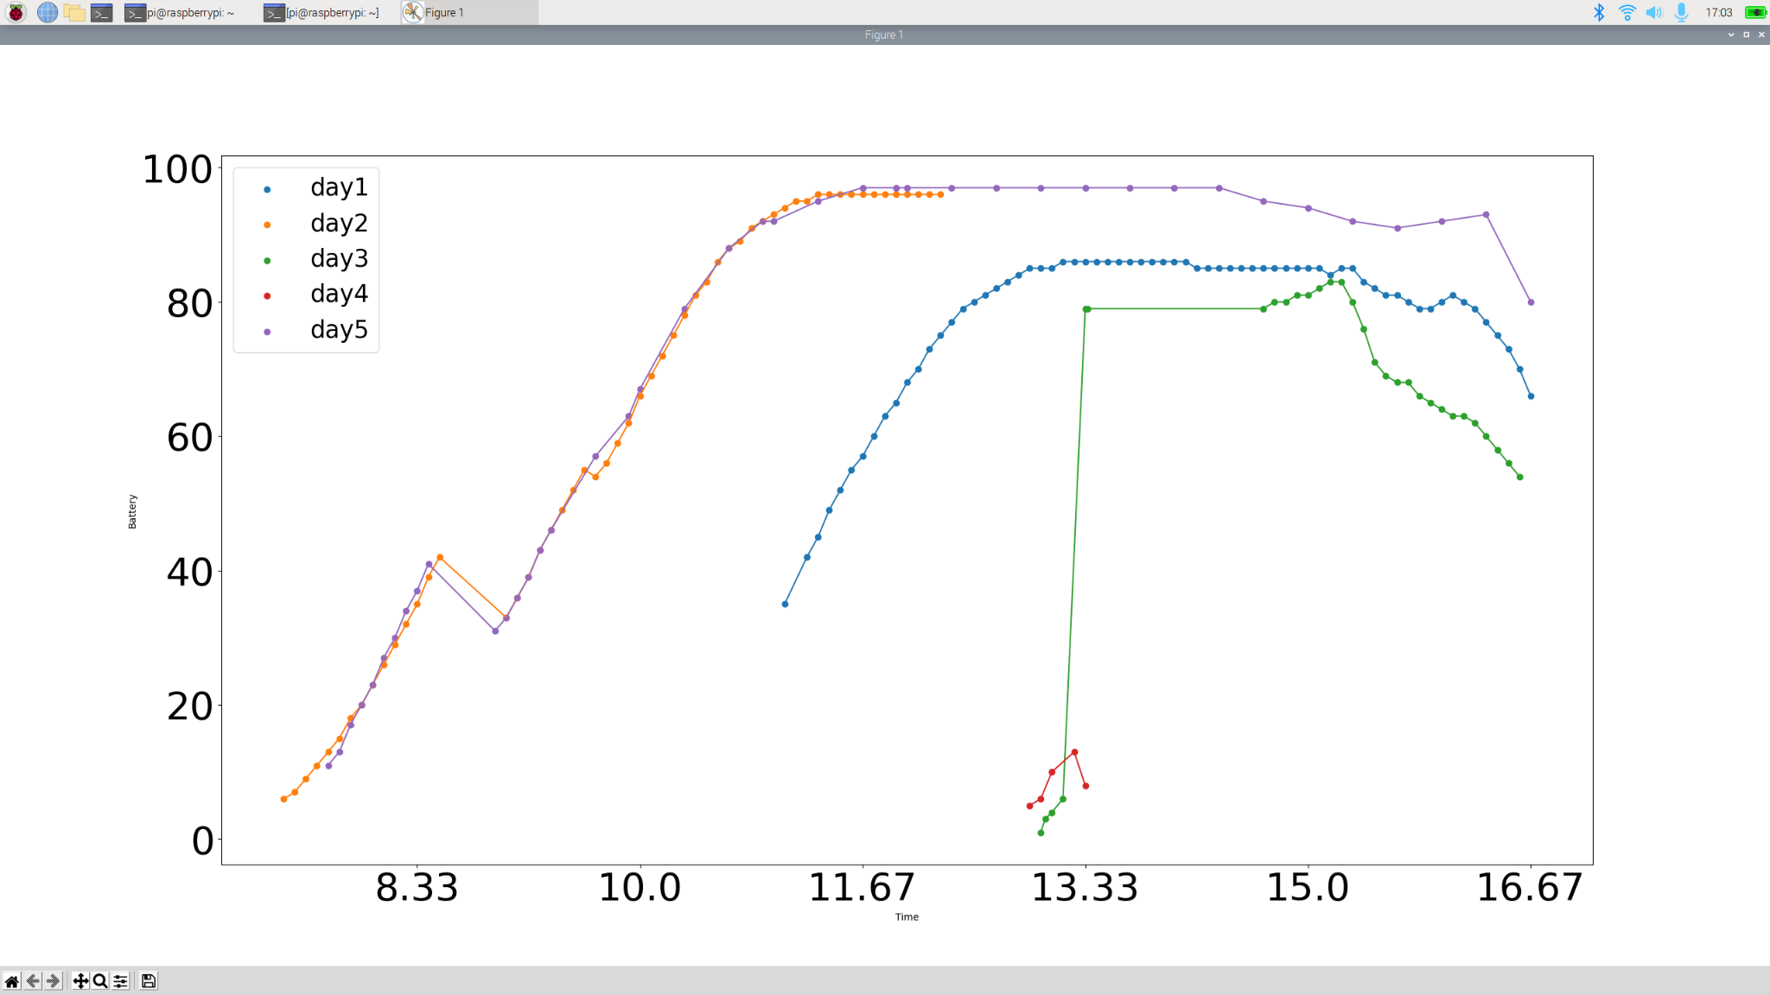
Testing at Local Creek
Impressive charging capability with new solar panel.
Takeaway:
Battery will die once it stops charging. This is about an hour. We do not know from this figure what the charging status was. Just the battery capacity.
Voltage problems only solved when solar panel is on.

Slide 65
Studying behavior
Voltage to device may be a firmware/PiJuice issue. Device has ability to stay on very late.
Current draw nowhere near 3.0 A as listed on internet.Battery test indicates ~1.45 A
Reboots from power source even with low current draw (2.5 A changed to 1.5 A)
Effective
Does “PRESENT” get indicated for longer period / lower currents? Data required. Help control surges.
Does reboot working mean that a wakeup alarm will work?
I believe this to be the case.
Reboot start and pull current, then die. Similar to Wake Up.
Reboots always take 5 minute. Why? 15 minute alarm takes 45 minutes
Finicky.

